Slide 1
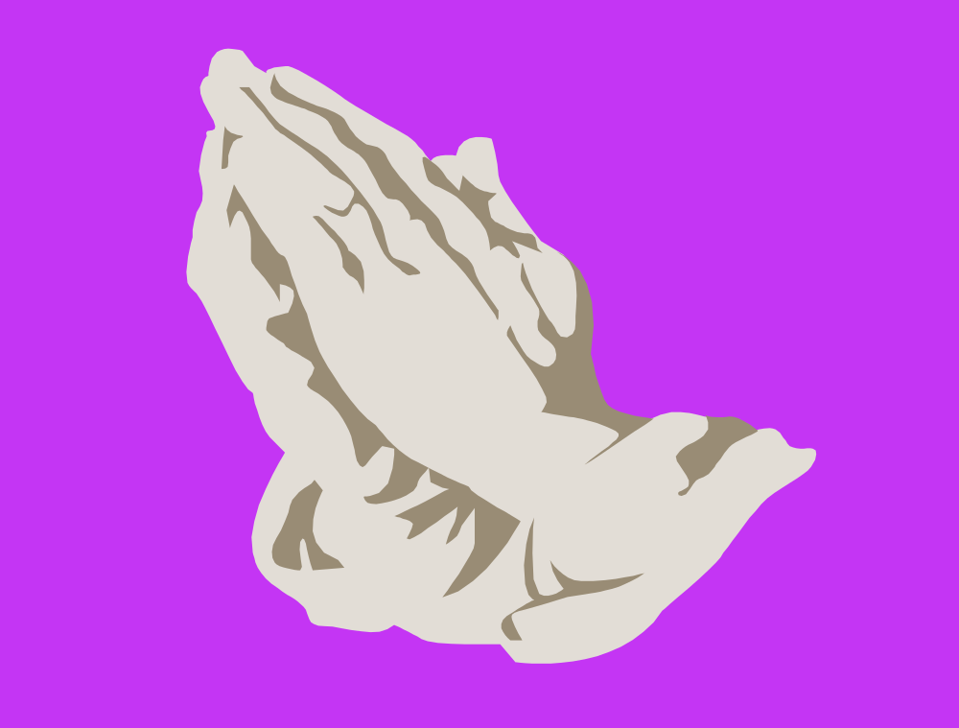
A PLAN FOR PRAYER - ACTS
Prayer of Adoration – Psalm 45:6-7
Prayer of Confession – Psalm 51:7-13
Prayer of Thanksgiving – James 5:15-16
Prayer of Supplication (Requests) Ephesians 5:19-20

